Slide 1
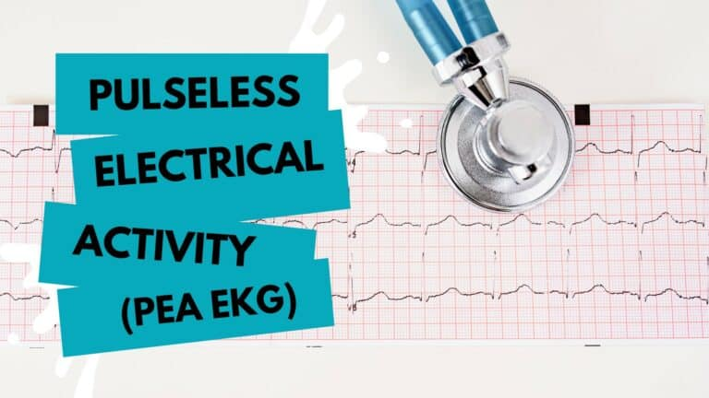
MR. UMAR AMINU IBRAHIM

Slide 2
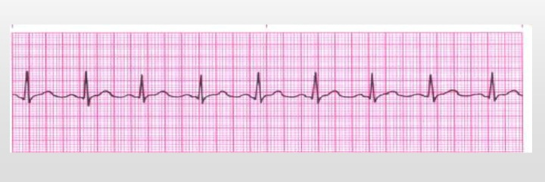
Pulseless Electrical Activity (PEA)
▪ Electricity is working, but the mechanics and plumbing are not.
▪ The absence of a palpable pulse and absence of myocardial muscle activity with
presence of organized electrical activity on the cardiac monitor. The patient is clinically dead despite some type of organized rhythm on monitor.

Slide 3
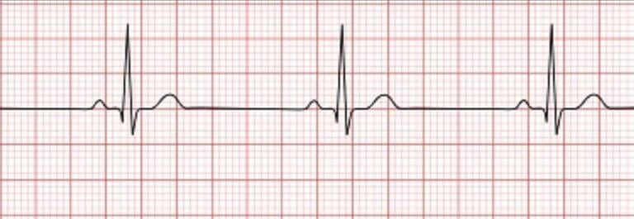
Pulseless Electrical Activity (PEA)
An example of pulseless electrical activity. True PEA is a “nonshockable” heart rhythm

Slide 4
Causes and S/S of (PEA)
Causes: H’s and T’s
• Hypovolemia #1 cause
• Hypoxia
• Hydrogen ions (acidosis)
• Hypo / Hyperkalemia
• Hypothermia
• Toxins
• Tamponade (cardiac)
• Tension pneumothorax
• Thrombosis
• Trauma
• Massive MI
• Overdose of tricyclic antidepressants
Signs and Symptoms
▪ Pulselessness
▪ Loss of consciousness
▪ No palpable BP
Medical Treatment
▪ Determine cause & treat
▪ CPR

Slide 5
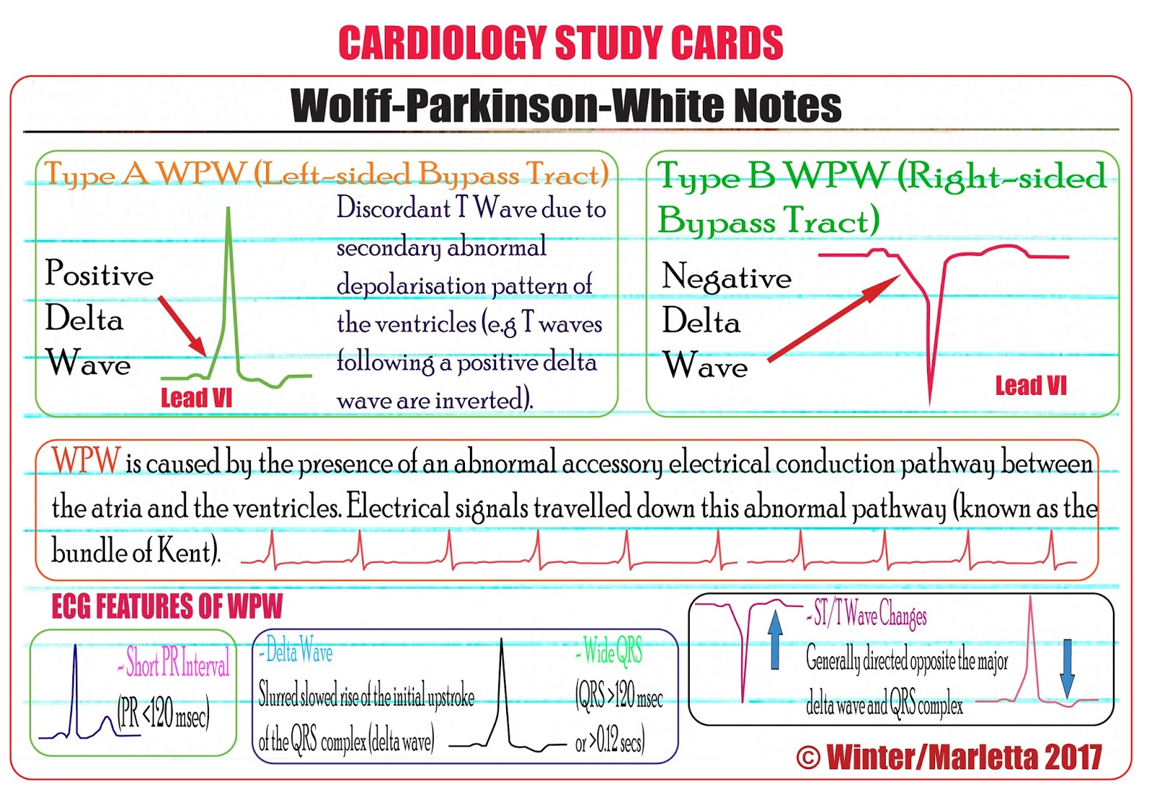
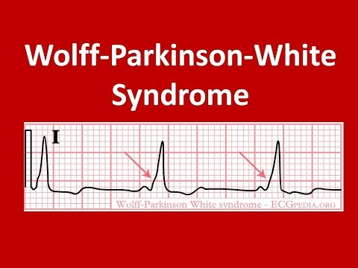
PR INTERVAL

Slide 6
Overview of Wolff-Parkinson-White (WPW) Syndrome
WPW Syndrome refers to the presence of a congenital accessory pathway (AP) and episodes of tachyarrhythmias. The term is often used interchangeablely with pre-excitation syndrome.
First described in 1930 by Louis Wolff, John Parkinson and Paul Dudley White.
Incidence is 0.1 – 3.0 per 1000
Associated with a small risk of sudden cardiac death

Slide 7
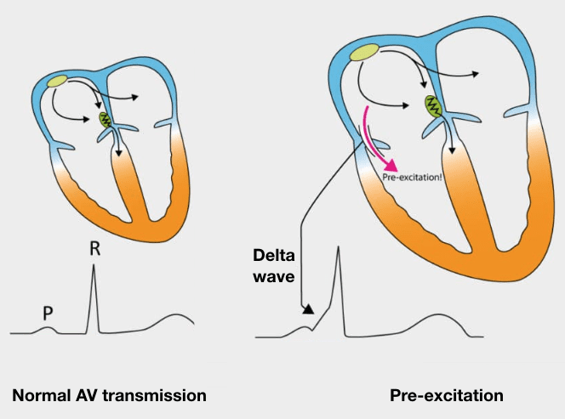

Slide 8
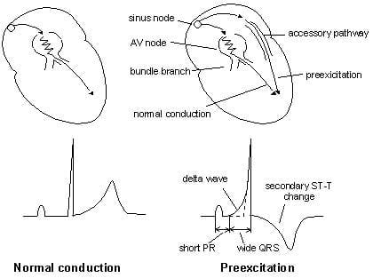

Slide 9
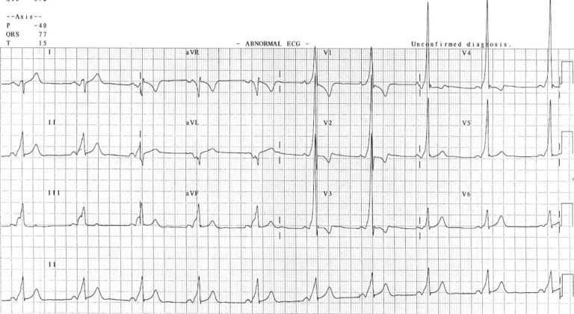

Slide 10
• Sinus rhythm with a very short PR interval (< 120 ms)
• Broad QRS complexes with a slurred upstroke to the QRS complex — the delta wave
• Dominant R wave in V1 suggests a left-sided AP, and is sometimes referred to as “Type A” WPW
• Tall R waves and inverted T waves in V1-3 mimicking right ventricular hypertrophy (RVH) — these changes are due to WPW and do not indicate underlying RVH
• Negative delta wave in aVL simulating the Q waves of lateral infarction — this is referred to as the “pseudo-infarction” pattern

Slide 11
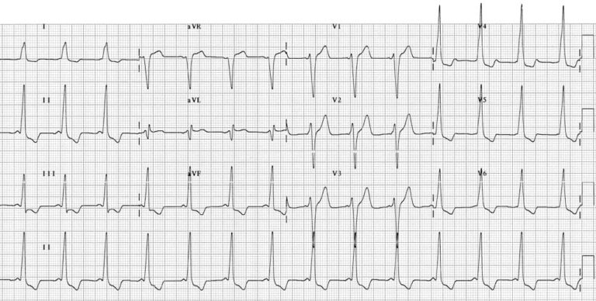

Slide 12
• Sinus rhythm with very short PR interval (< 120 ms)
• Broad QRS complexes with a slurred upstroke to the QRS complexes — the delta wave
• Dominant S wave in V1 indicates a right-sided AP — sometimes referred to as “Type B” WPW
• Tall R waves and inverted T waves in the inferior leads and V4-6 mimic the appearance of left ventricular hypertrophy (LVH) — again, this is due to WPW and does not indicate underlying LVH.

Slide 13
Corected QT interval (QTc)
QTc simply means corrected QT interval.
QT interval contains entire duration of a ventricular activity, from the period of its depolarization to its repolarization.
Normal QT interval = 0.36 — 0.44s (9 - 11 small boxes)
QTc prolongation can vary in gender; female (360 — 450msec) and male (360 h 470msec).
Formula = QT (msec)
√(R — R interval) in seconds. (Bazett criteria)

Slide 14
HOW TO CALCULATE QTc
Calculate QT interval:
Count small boxes from the end of PR segment to the end of T wave.
Multiply the result by 0.04s to covert to seconds.
Convert your answer which is in seconds to milliseconds by multiplying by 1000.
2. Calculate R-R interval
Calculate the heart rate first. Then find R-R interval;
R-R interval = 60 Heart rate

Slide 15
DRUGS THAT PROLONGED QTc
Prolonged QT | • Anti-Arrhythmics e.g amiodarone. • Anti-Biotics e.g Ketoconazole. • Anti-psychotics e.g Haloperidol. • Anti-depressants e.g Amitriptyline. • Anti-emetics e.g Metoclopramide. • HypoK/HypoMg/HypoC
Shortened QT | • HyperCa/HyperK

Slide 16
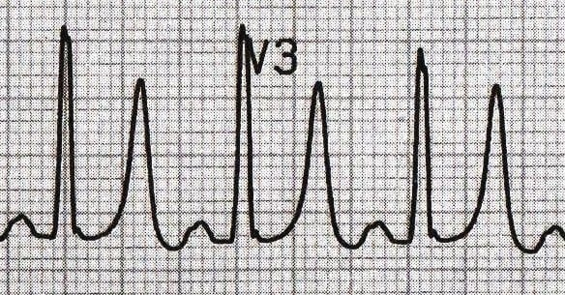
Tall and tainted T wave (Hyperkalemia)
Tall, narrow, symmetrically peaked T-waves are characteristically seen in hyperkalaemia

Slide 17
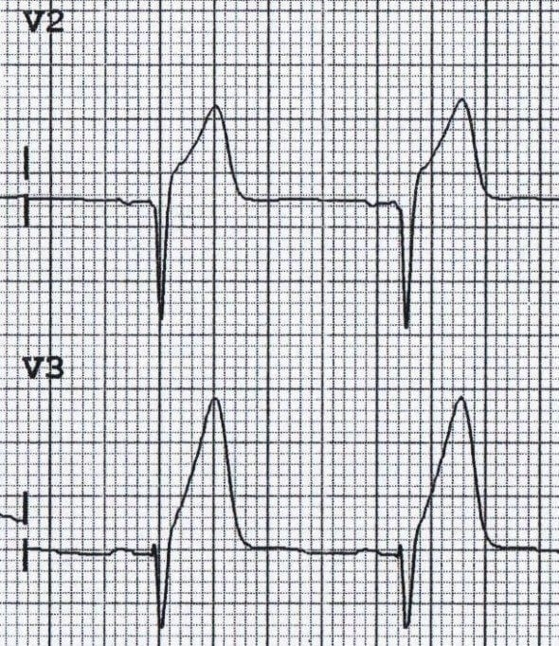
Hyperacute T wave
Broad, asymmetrically peaked or ‘hyperacute’ T-waves (HATW) are seen in the early stages of ST-elevation MI (STEMI).

Slide 18
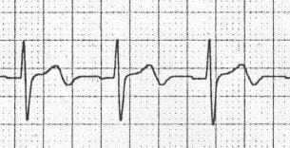
Biphasic T waves
There are two main causes of biphasic T waves:
• Myocardial ischaemia
• Hypokalaemia
Biphasic T waves due to ischaemia – T waves go UP then DOWN.

Slide 19
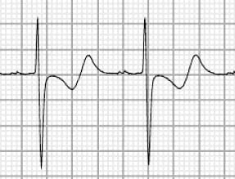
Biphasic T waves
Biphasic T waves due to Hypokalaemia – T waves go DOWN then UP.

Slide 20
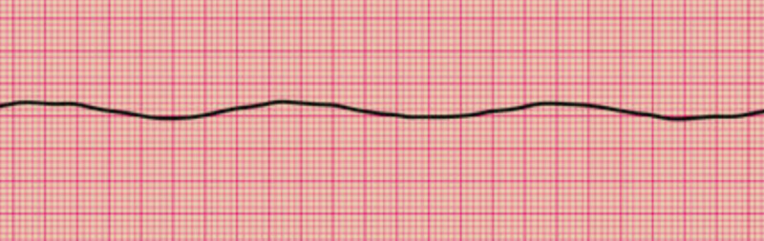
Asystole (Cardiac Standstill)
▪ Ventricular standstill
▪ No palpable pulse
▪ No measurable BP
▪ Loss of consciousness
Zero Heart rate: Asystole
Treatment: CPR. Keep in mind that this is also " Nonshockable rhythm".

Slide 21
THANK YOU!

